Slide 1
To Infinity And Beyond
Database For Multi-airlines Group
INFO330 Group 5 Qikun Liu, Chengyang Li, Isan Cho

Slide 2





International
Domestic
Domestic
Budget

Slide 3
Problem Statement
What we are trying to solve:
Allow stakeholders to access needed information to build a multi-carriers company.
lower the overhead cost (on time/money)
track special needs of customers for customer retainment rate (better customer experience)
Human/Capital Resource optimization

Slide 4
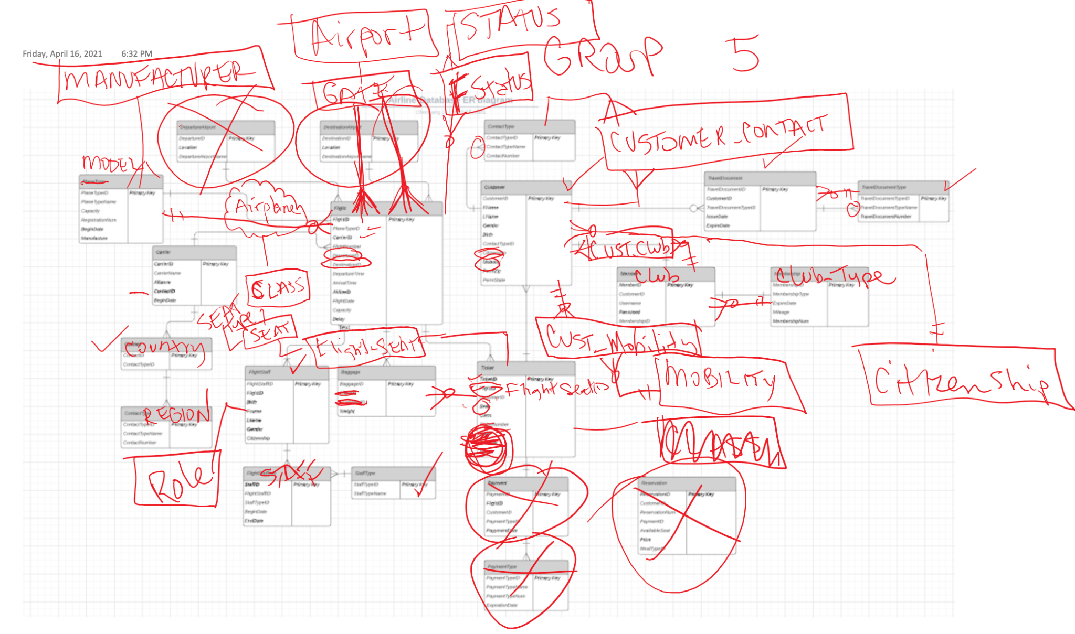
ERD Draft 1

Slide 5
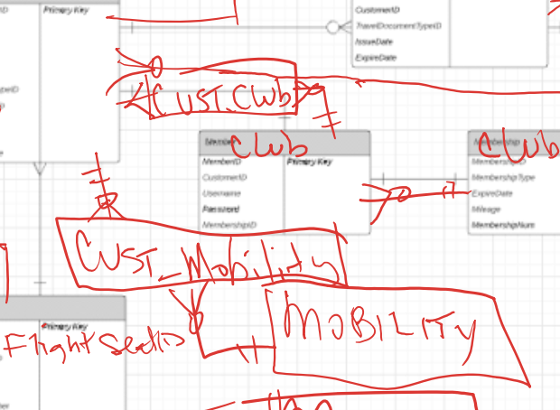
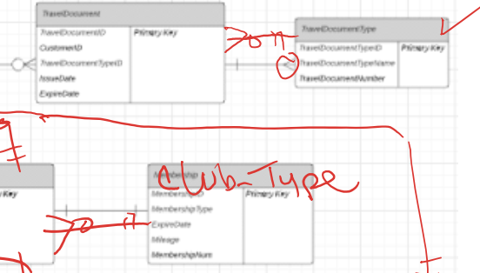
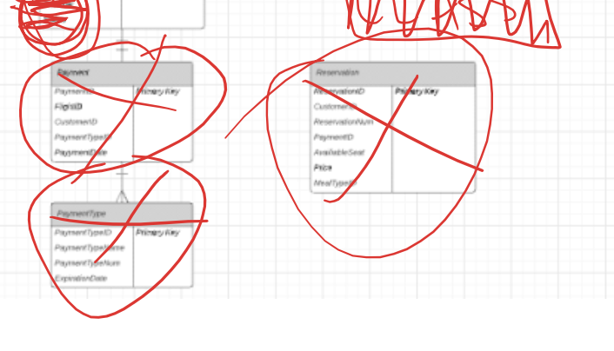
ERD Draft 1
Wrong Relationship
Wrong and redundant table
Wrong cross-foot notation

Slide 6
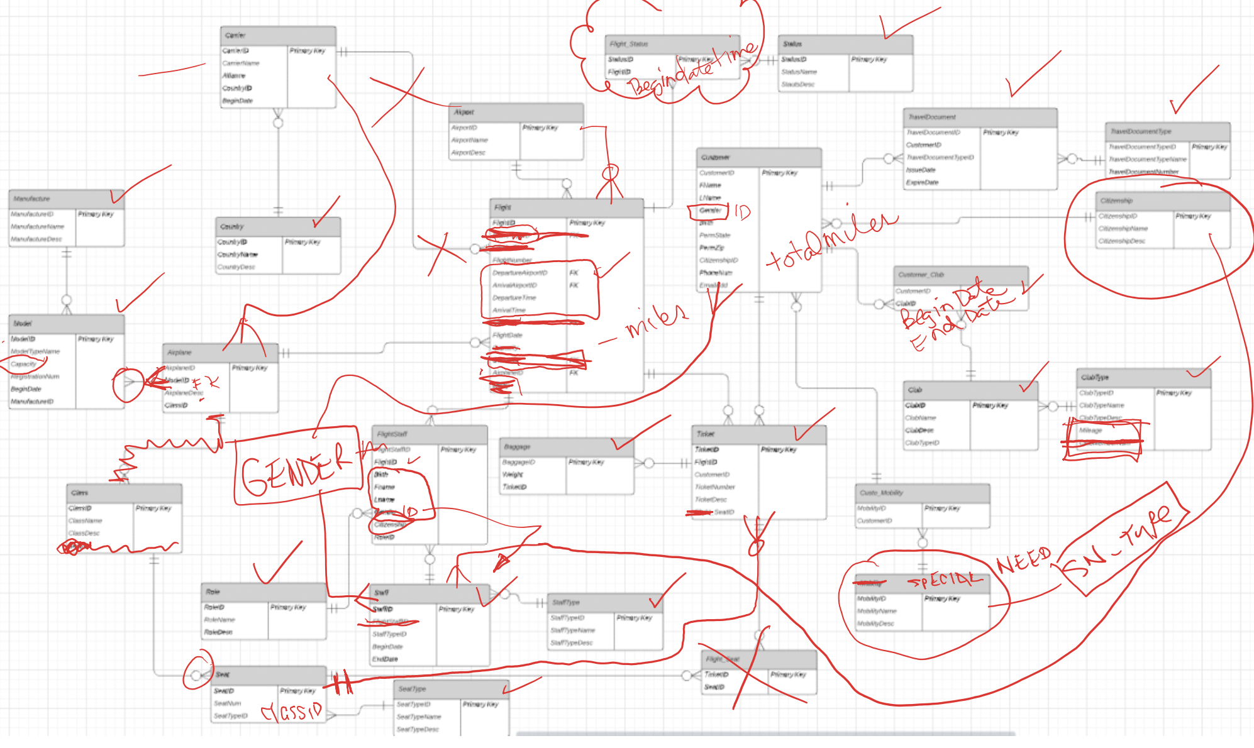
ERD Draft 2

Slide 7
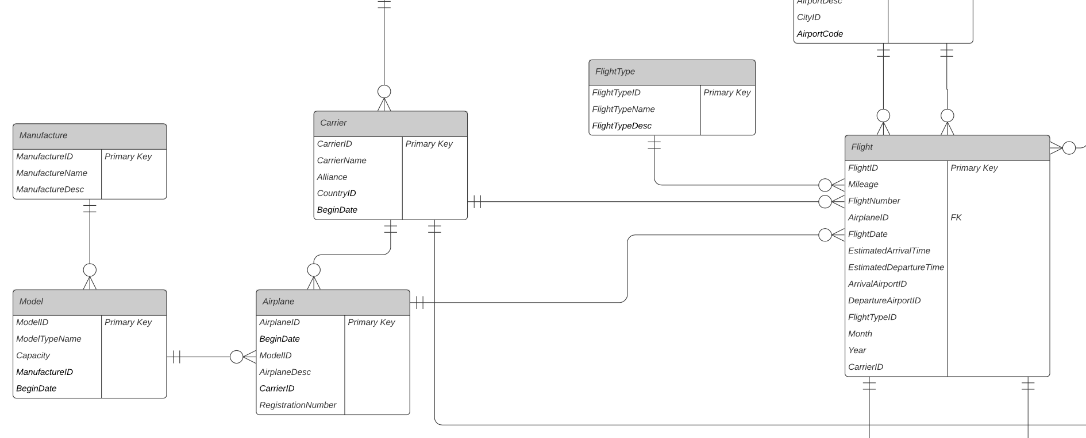
Changes Made in Final ERD

Slide 8
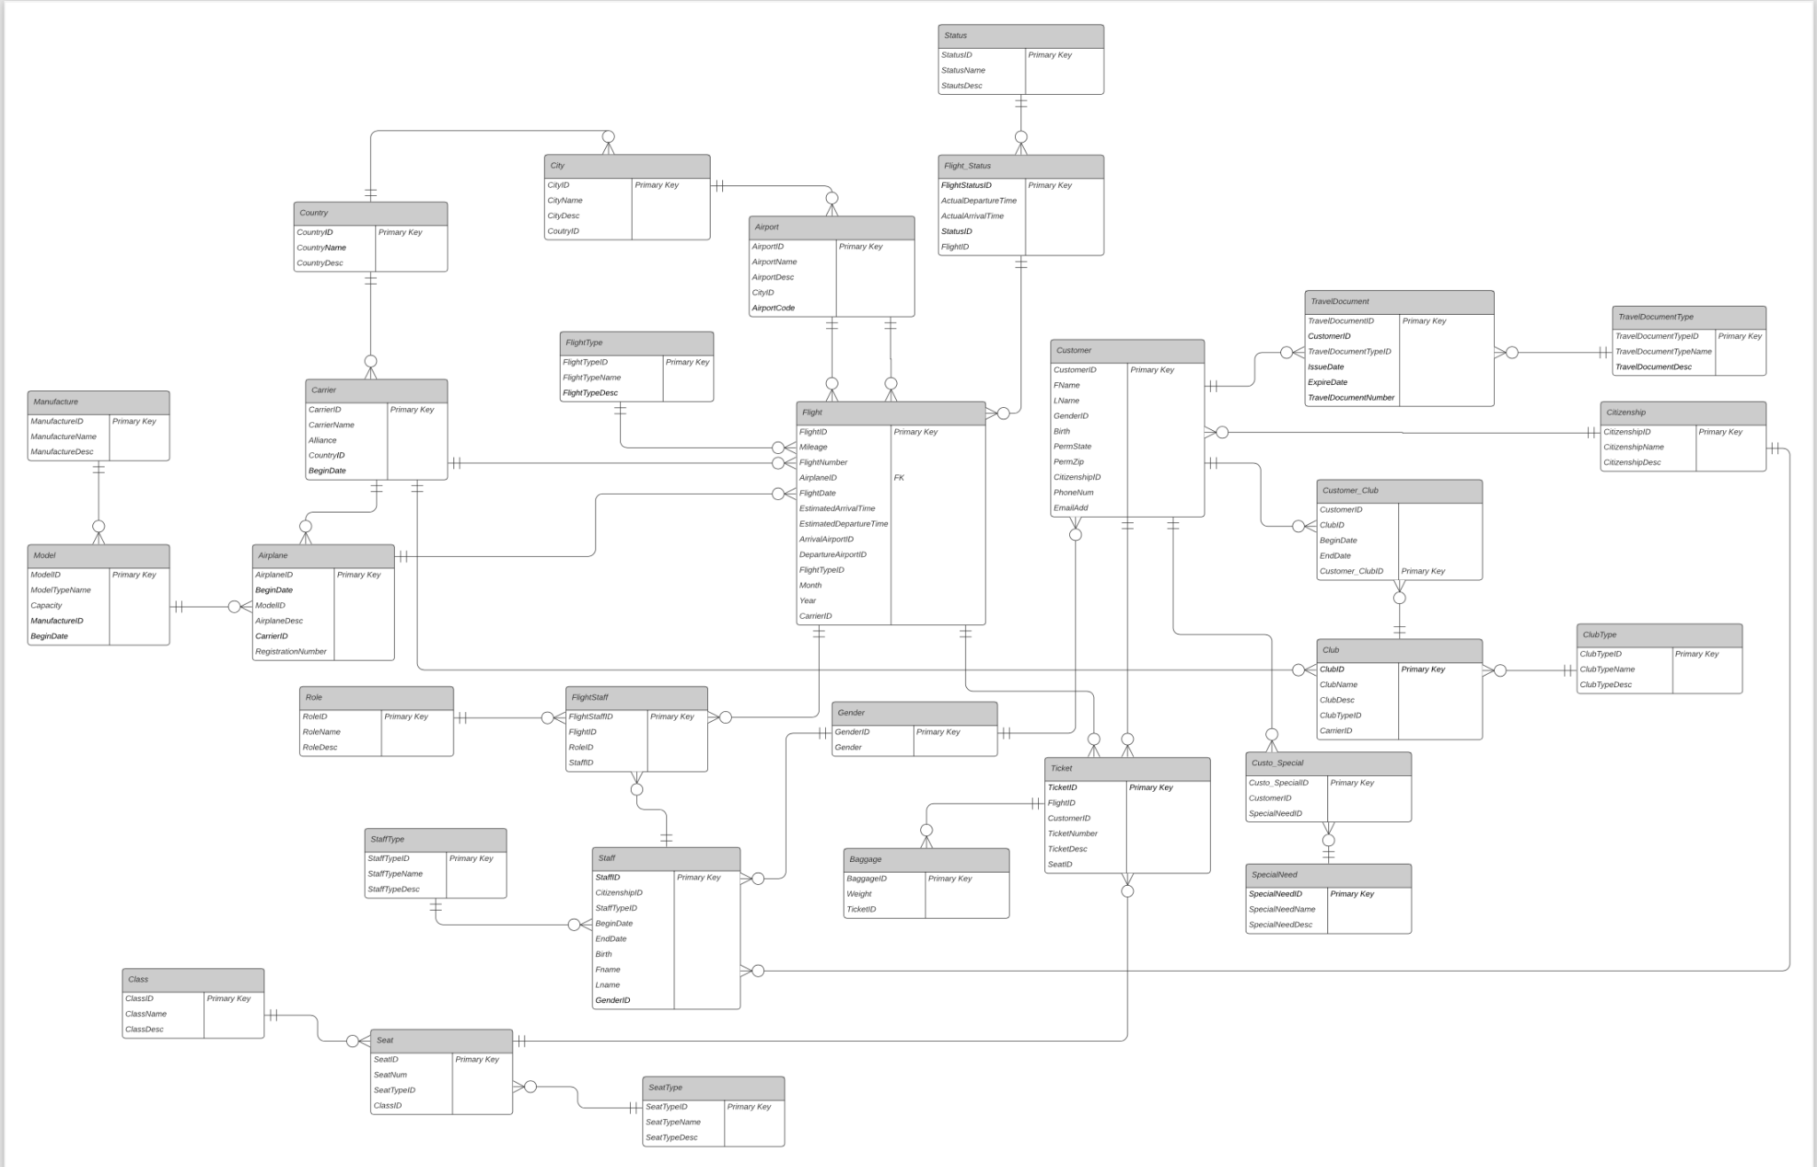

Slide 9
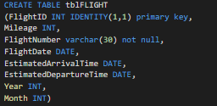
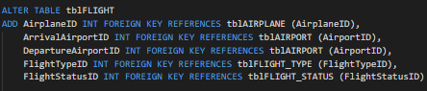
Data Definition Language
Divide tasks
Create table
Specify columns and type names
Safely handle foreigh key condition
Notes:
How to translate entities into physical tables
What attributes to use for columns of the physical tables
Which columns of the tables to define as keys
How to denormalize the tables
How to resolve many-to-many relationships
What designs can take advantage of hash access

Slide 10
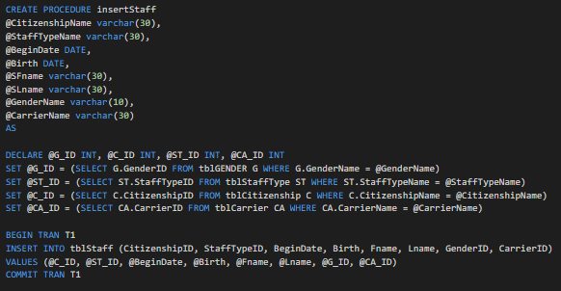
Stored Procedure
The main purpose of stored procedure is to hide direct SQL queries from the code and improve performance of database operations.
Notes:
Scalability – ...
Maintainability – ...
Security –

Slide 11
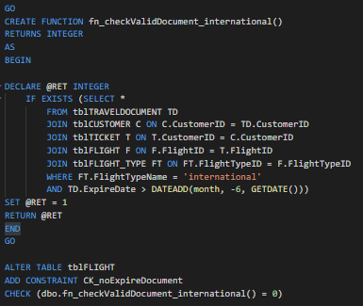
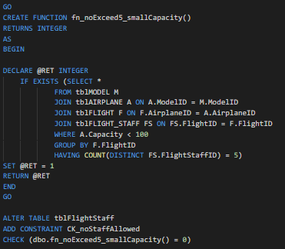
Business Rule

Slide 12
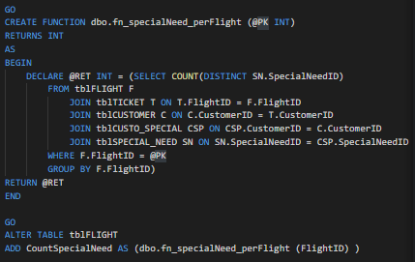
Computed Column
We use computed columns to automatically manage data which is calculated based on other columns. We can keep track of useful information like:
Different types of special need per flight
Count of on-time flights per airline
Sum ofbaggage weight per flight

Slide 13


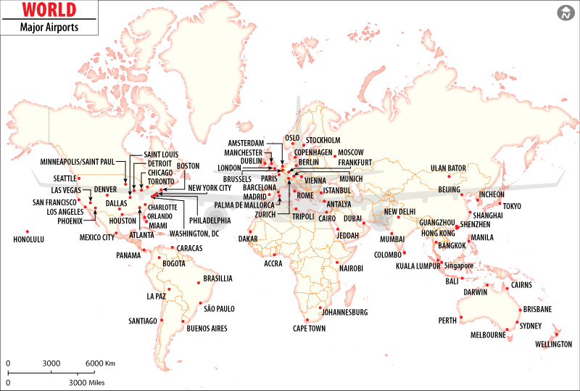
data visualization
Resource
Pandemic Impact
Special Need
Notes:
Lower the crew members on airports that’s has lower flights (human resource /overhead cost)

Slide 14
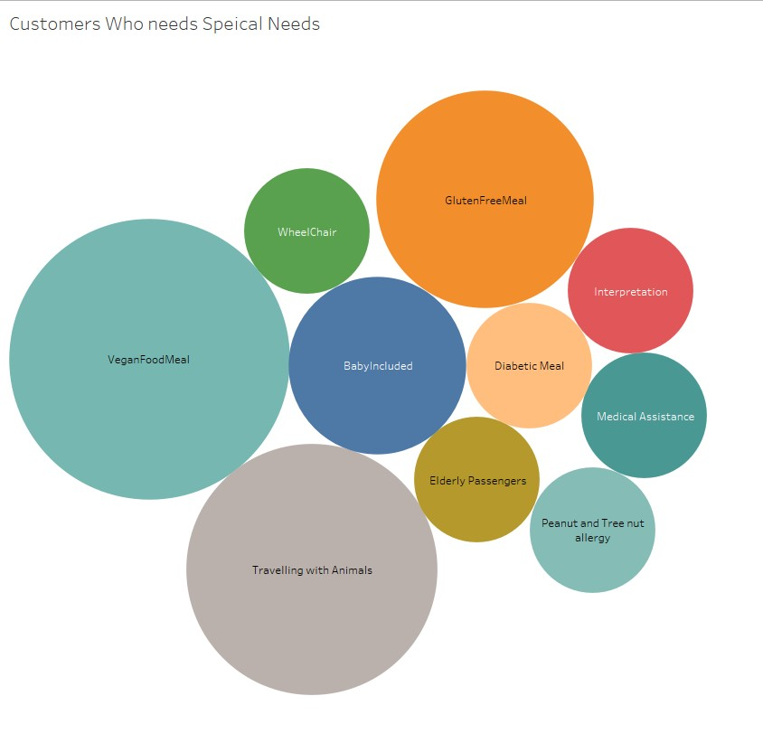


Slide 15
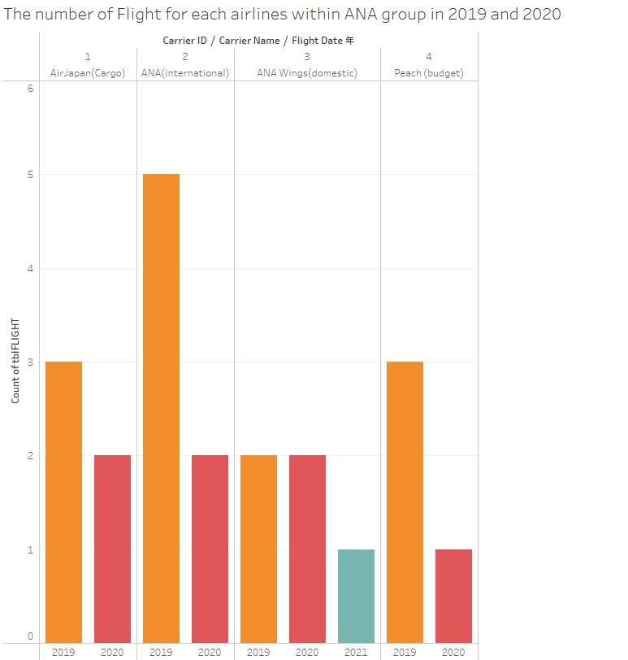

Slide 16
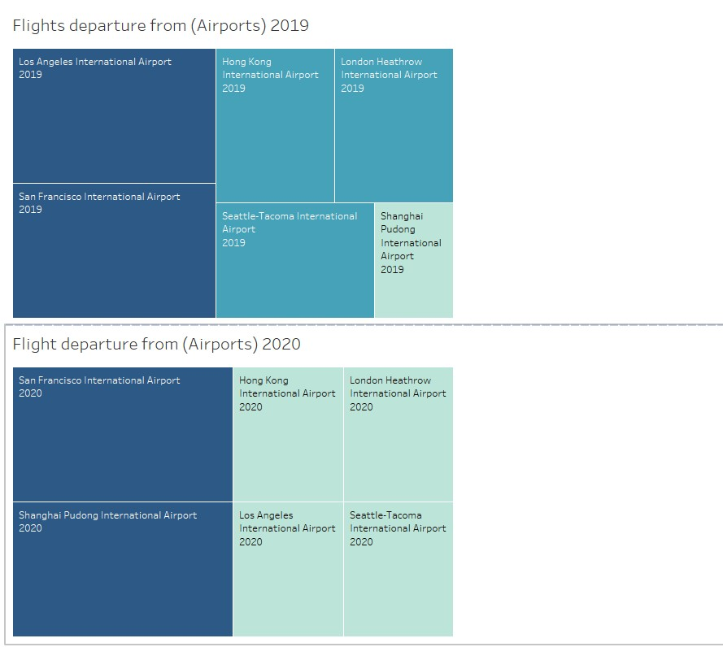
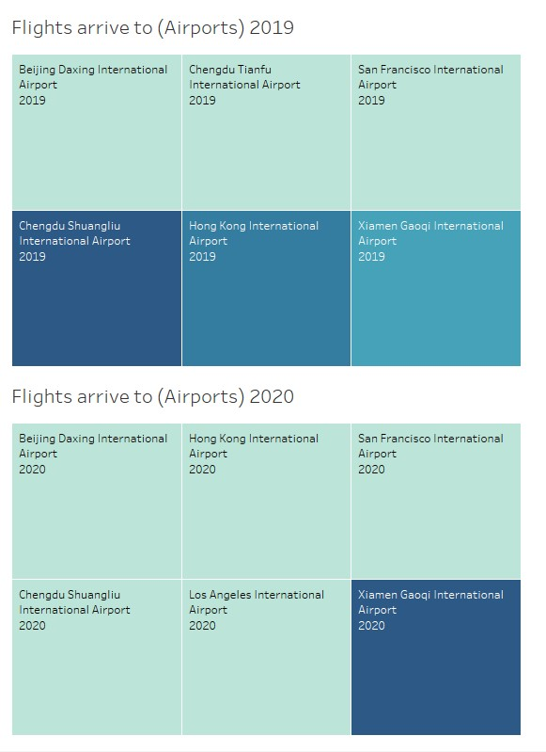

Slide 17
Thank you!

